Slide 1

Spatiotemporal Analysis of Public Sentiment in Europe and the USA on Low-Carbon Energy Sources
Caleb Chia We Keat
Y1981136
Presentation date: 19.09.22

Slide 2
Project Background
Business Problem:
Burning fossil fuels emits the most greenhouse gas in the US
Mitigating solution: Low-carbon energy sources
Public willingness and active involvement is crucial
Business Objective:
To design better policies and adoption strategies
Benefits governments and organisations like UN
Lobbyists and environmentalists influencing policies (e.g. Shell)
Using Social media to understand public perception
Low-Carbon Energy:
Clean
Renewable
Green

Slide 3
Data Collection (Twitter)
Tweet query
Contains ‘renewable energy’, ‘clean energy’, and ‘green energy’ or
Contains ‘#renewableenergy’, ‘#cleanenergy’, and ‘#greenenergy’
Limited time period
1 June 2021 to 1 June 2022 (1 year)
Location: Europe and the US
Must be geotagged and contain location data
Language: English
date_time | content | hashtags | language | user_location | coord | place
2022-05-29 14:27:04+00:00 | Ch7 News Federal Election – Business is booming for renewables. Natural Solar. #Renewables #Energy … | ['Renewables', 'Energy', 'Renewable', 'GreenEnergy'] | en | New Jersey, USA | Coordinates(longitude=-72.92308028, latitude=41.3115651) | Place(fullName='New Haven, CT', name='New Haven', type='city', country='United States', countryCode='US')

Slide 4
Volume Analysis
Scraped Data | No. of Tweets
Renewable Energy tweets from the US | 3,637
Clean Energy tweets from the US | 5,317
Green Energy tweets from the US | 2,138
Total tweets from the US | 11,092
Renewable Energy tweets from Europe | 3,689
Clean Energy tweets from Europe | 1,091
Green Energy tweets from Europe | 2,344
Total tweets from Europe | 7,124
Total No. of Tweets | 18,216

Slide 5
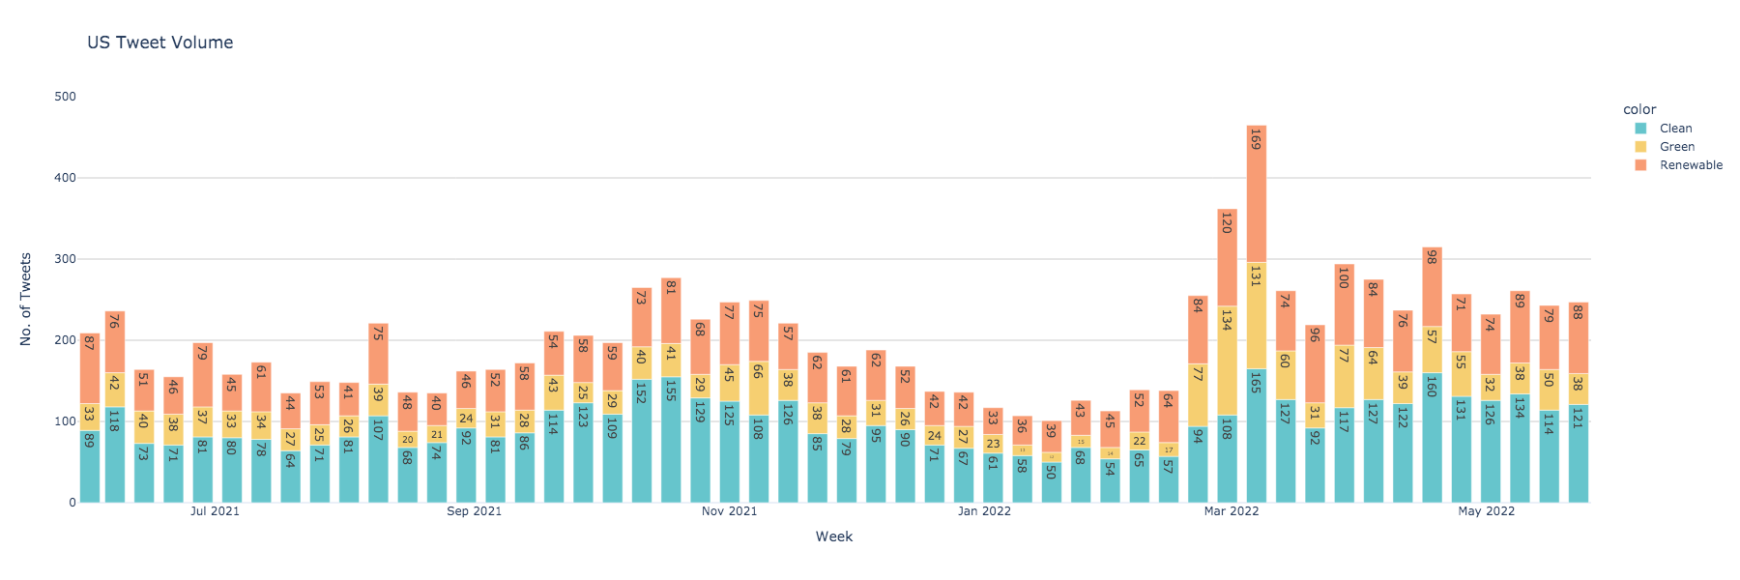
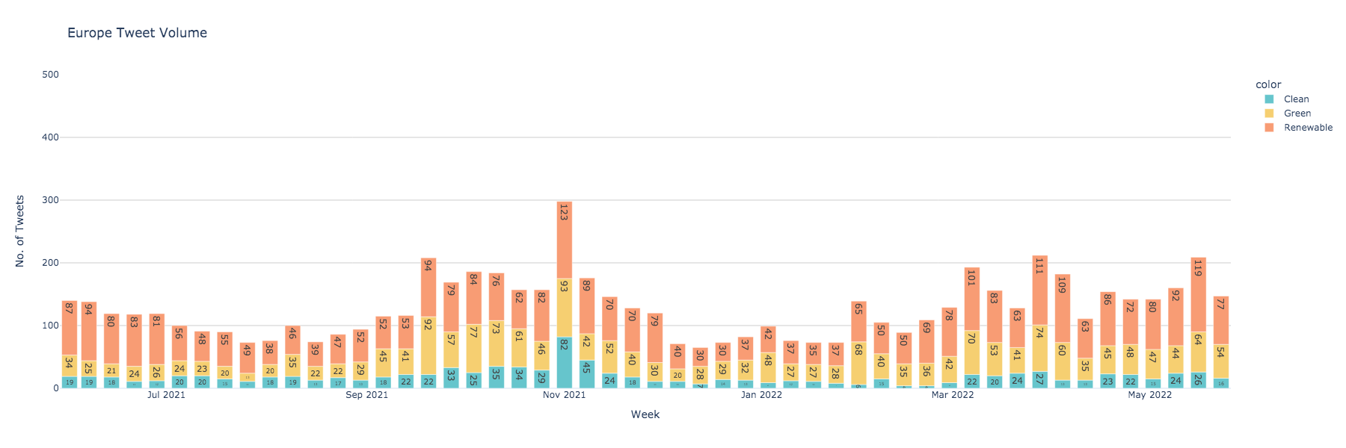
Russia-Ukraine War
COP26

Slide 6
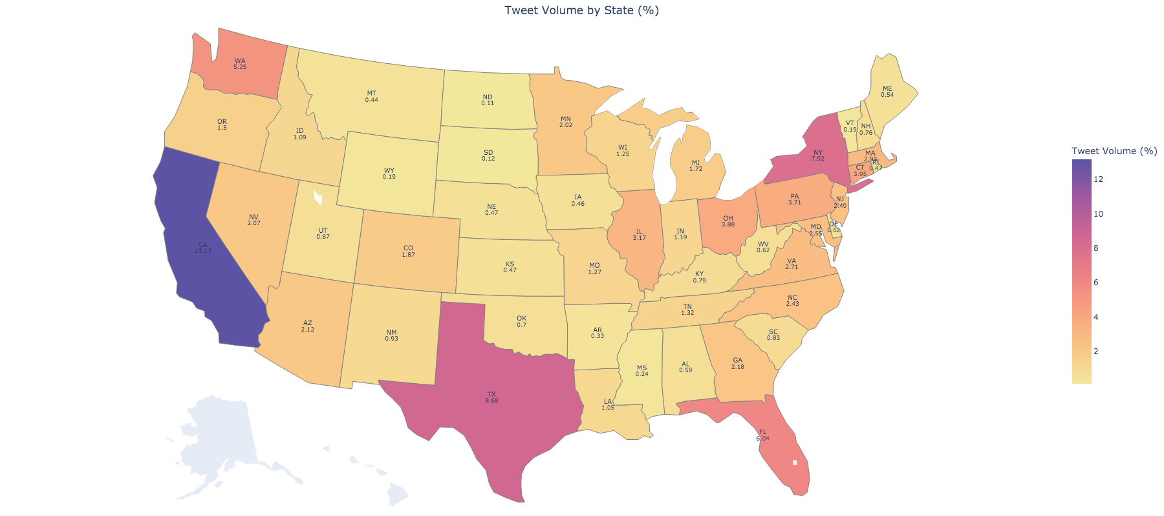
Volume Analysis (US)
State | Proportion of Tweets (%)
California | 13.17
Texas | 8.68
New York | 7.92
Florida | 6.04
Washington | 5.25

Slide 7
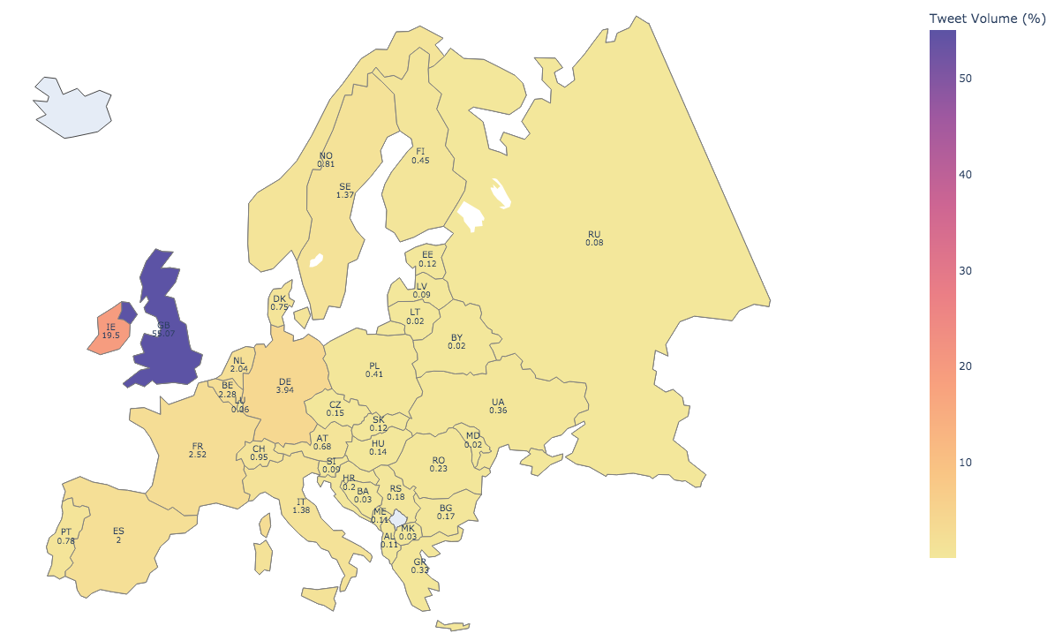
Volume Analysis (Europe)
Country | Proportion of Tweets (%)
United Kingdom | 55.07
Ireland | 19.50
Germany | 3.94
France | 2.52
Belgium | 2.28

Slide 8
Sentiment Analysis Model
Valence Aware Dictionary for Sentiment Reasoning (VADER)
Robust unsupervised, lexicon-based model
Maps labelled lexical features according to their semantic orientation
Does not require training in advance and computationally efficient
Returns a score from -1 (strongly negative) to 1 (strongly positive)
Specifically attuned to handle sentiments expressed in social media content
Able to handle and consider emojis, punctuations, capitalisations, and repeated words
Example: Sentence | VADER score
grabngoinfo.com is a FANTASTIC website for step by step machine learning tutorials. | 0.6523
grabngoinfo.com is a FANTASTIC FANTASTIC FANTASTIC website for step by step machine learning tutorials. | 0.9325
grabngoinfo.com is a FANTASTIC FANTASTIC FANTASTIC website for step by step machine learning tutorials! | 0.9359

Slide 9
Sentiment Analysis
Returns probabilities that the tweet is negative / neutral / positive
Compound score is calculated from the probabilities
Manual classification used to reduce false positives / negatives
Tweets with scores between –0.25 to 0.25 as neutral
Tweet | Negative | Neutral | Positive | Compound | Sentiment
I guess he’s never spoken to the Navajo, Shosh… | 0.108 | 0.823 | 0.069 | -0.2895 | Negative
Water is infinite. Energy to access it can be… | 0.106 | 0.805 | 0.089 | -0.1027 | Neutral
WE NEED A MANHATTAN PROJECT TO CLEAN UP PLASTI… | 0.066 | 0.713 | 0.221 | 0.7430 | Positive

Slide 10
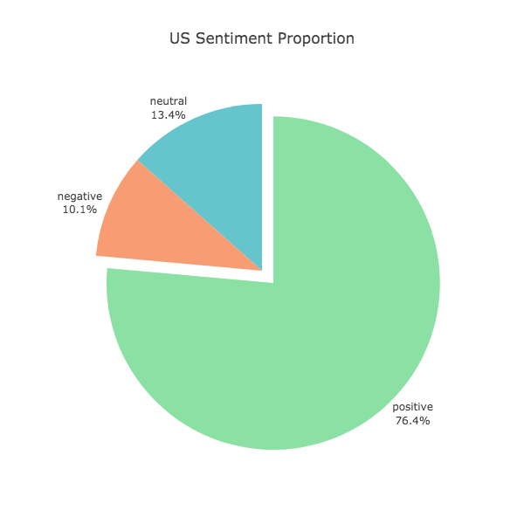
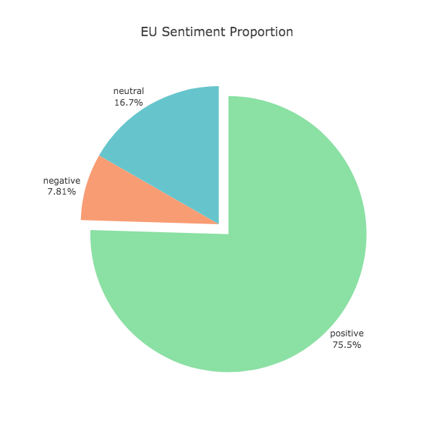
Results (Sentiment Proportion)
US Tweets | Count
Positive Tweets | 8070
Neutral Tweets | 1419
Negative Tweets | 1070
Europe Tweets | Count
Positive Tweets | 5023
Neutral Tweets | 1112
Negative Tweets | 520

Slide 11
Results (US Word Cloud)
US Positive Tweets:
US Negative Tweets:

Slide 12
Results (Europe Word Cloud)
Europe Positive Tweets:
Europe Negative Tweets:

Slide 13
Average Sentiment of US States
The average score of all US states is greater than 0
Top 5 states with highest sentiment
Top 5 states with lowest sentiment
State | Average Sentiment
Vermont | 0.754
Wyoming | 0.613
Arkansas | 0.591
Utah | 0.555
Oklahoma | 0.549
State | Average Sentiment
South Dakota | 0.201
New Mexico | 0.313
Maine | 0.329
Kansas | 0.340
North Dakota | 0.349

Slide 14
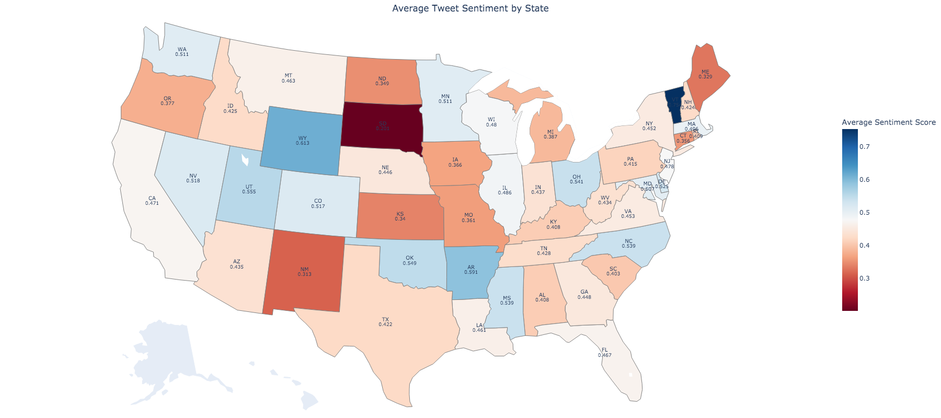
Average Sentiment of US States

Slide 15
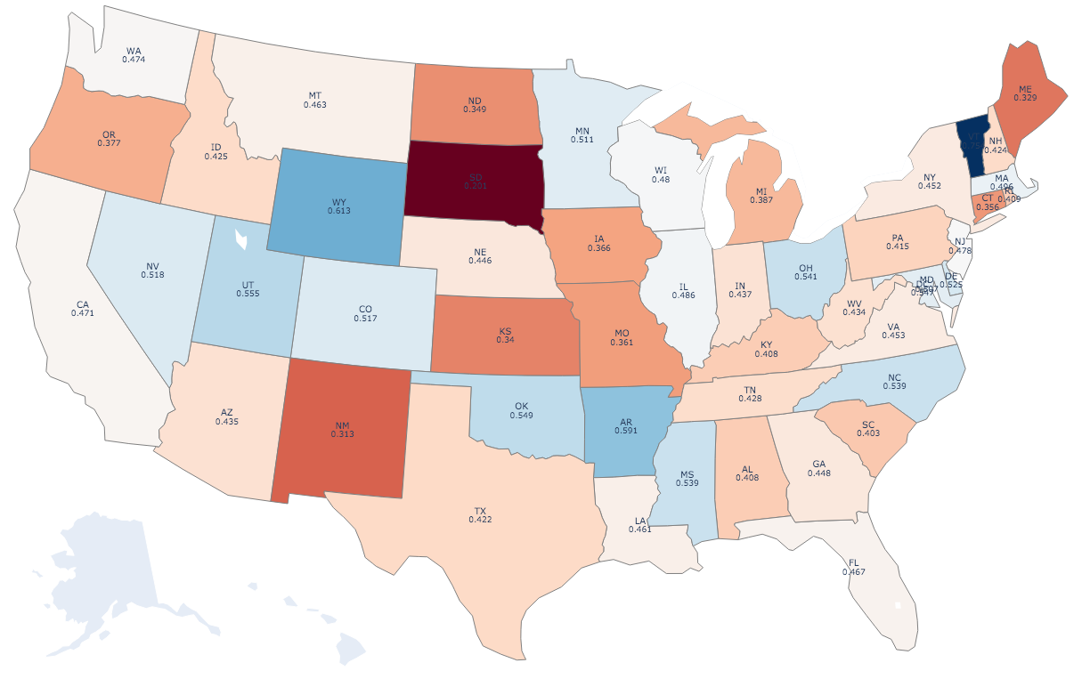
Average Sentiment of US States
Average sentiment by political landscape:
Blue States (Democratic) | Red States (Republican)
0.460 | 0.448

Slide 16
Average Sentiment of European Countries
Apart from the Republic of Slovenia, the average score of all European countries is greater than 0
Top 5 countries with highest sentiment
Top 5 countries with lowest sentiment
Country | Average Sentiment
Lithuania | 0.945
Monaco | 0.858
Moldova | 0.822
Luxembourg | 0.787
Republic of Belarus | 0.746
Country | Average Sentiment
Republic of Slovenia | -0.084
Isle of Man | 0.039
Turkey | 0.240
Malta | 0.354
Gibraltar | 0.372

Slide 17
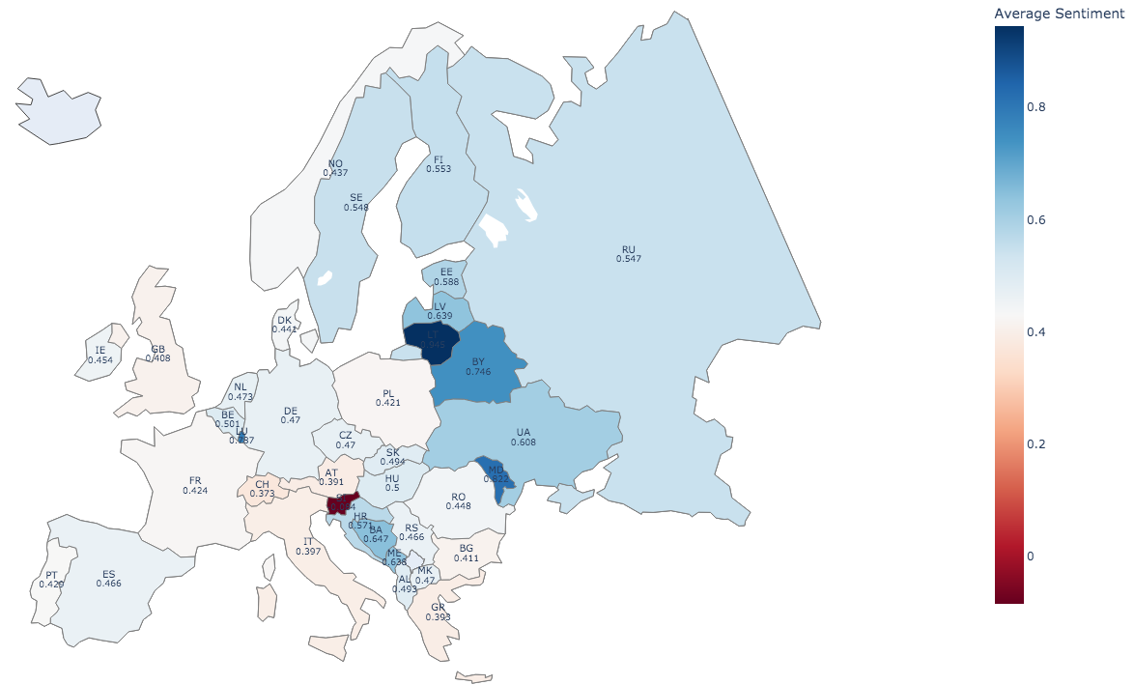
Average Sentiment of European Countries

Slide 18
Future Works
Improvements for future works given more time:
Expand sources for data collection
Tweet data may not be fully representative due to platform demographics (Kim et al., 2021)
Twitter users are younger and usually more politically liberal
Consider expanding to more platforms and including conventional collection methods
Expand to include languages
European languages were not captured due to limitations in language capabilities
This resulted in significantly less data for countries where English may not be native
Dahal et al. (2019) suggests translating tweets or adopting a supervised technique that can handle multiple languages if there is enough data in foreign languages

Slide 19
Conclusion
Comprehensive overview of geographical variation in public sentiment
The majority of public sentiment in US and Europe is positive
Keywords from positive/negative tweets suggest topics of high importance to the public
States or countries that wish to gain public support for energy transition can consider looking into these areas of high importance
Aids governments and organisations like UN to design better adoption strategies and low-carbon emission policies
Use of social media to evaluate sentiment in real-time
Social media offers valuable, updated data which may be beneficial during the lack of formal statistics

